Slide 1
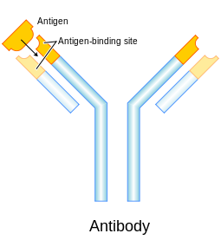
Provider of Global Contract Research Services Accelerating Preclinical Research, Drug Discovery & Therapeutics
Services > ELISA and Cell-based Assays
ELISA (Enzyme-linked Immunosorbent Assay)
Plate-based assay technique designed for detecting and quantifying substances such as peptides, proteins, antibodies and hormones.
The substance’s binding activity is measured as a linear spectrophotometric response and quantified against a standard curve.
Heavy Chain
F_{AB}
(Antigen Binding Fragment)
F_{C} Fragment
Light Chain
src: en.wikipedia.org/wiki/Antibody
Altogen Labs • 11200 Manchaca Road #203 • Austin • TX • 78748 • USA
Telephone • 512 433 6177 • email • info@altogenlabs.com

Slide 2
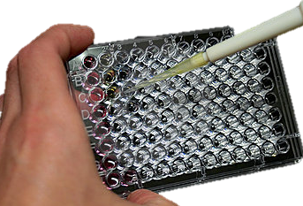
Provider of Global Contract Research Services Accelerating Preclinical Research, Drug Discovery & Therapeutics
Services > ELISA and Cell-based Assays
ELISAs are typically performed in polystyrene plates which will passively bind a known antibody or antigen to the plate surface. This is known as the solid phase.
Altogen Labs • 11200 Manchaca Road #203 • Austin • TX • 78748 • USA
Telephone • 512 433 6177 • email • info@altogenlabs.com

Slide 3
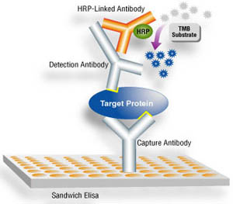
Provider of Global Contract Research Services Accelerating Preclinical Research, Drug Discovery & Therapeutics
Services > ELISA and Cell-based Assays
The plate is loaded with a liquid sample containing the antigen and buffer washes remove any unbound antigen or antibody from the wells.
Only target antigen that has bound to the solid phase will remain.
A buffer containing antibodies and enzyme-conjugated antibody is added to the wells. Bound complexes will be detected by enzyme produced colorimetric substrate.
A target antigen bound by 2 capture antibodies detected by HRP activity in a sandwich ELISA
Altogen Labs • 11200 Manchaca Road #203 • Austin • TX • 78748 • USA
Telephone • 512 433 6177 • email • info@altogenlabs.com

Slide 4
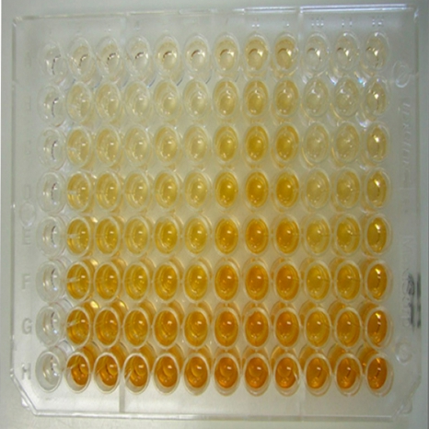
Provider of Global Contract Research Services Accelerating Preclinical Research, Drug Discovery & Therapeutics
Services > ELISA and Cell-based Assays
Representative ELISA
Enzyme production of colorimetric substrate produces an optical signal, which is directly correlated to the amount of bound analyte and accordingly, the concentration of analyte in the original solution.
The bottom wells have the most product, hence have the most bound analyte
Analyte Concentration
Optical Density
Optical density is directly proportional to the amount of bound analyte
Analyte Concentration
Altogen Labs • 11200 Manchaca Road #203 • Austin • TX • 78748 • USA
Telephone • 512 433 6177 • email • info@altogenlabs.com

Slide 5
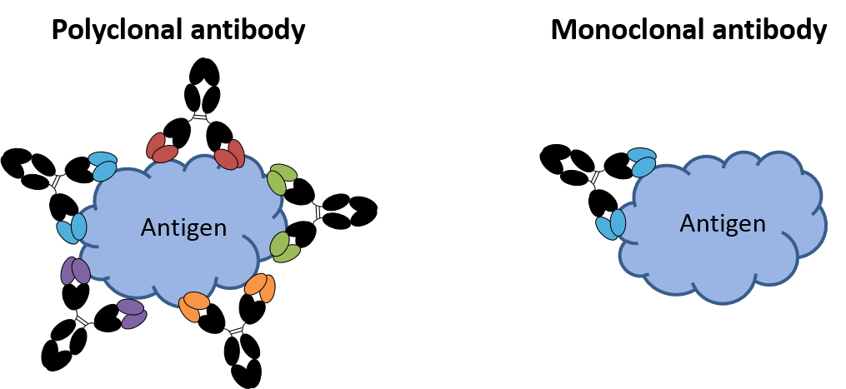
Provider of Global Contract Research Services Accelerating Preclinical Research, Drug Discovery & Therapeutics
Services > ELISA and Cell-based Assays
ELISA
Customizable monoclonal and polyclonal antibodies make the ELISA a very versatile assay able to detect most targets of interest, with high affinity, specificity and sensitivity.
Altogen Labs (www.altogenlabs.com) offers:
Antibody Testing, Custom labeling, Biotinylation, Purification
Monoclonal and Polyclonal Antibody Development
ELISA Assay Development
ELISA Platform Optimization
ELISA Assay Format Modification
Polyclonal Antibodies can target more than one antigen epitope
Altogen Labs • 11200 Manchaca Road #203 • Austin • TX • 78748 • USA
Telephone • 512 433 6177 • email • info@altogenlabs.com

Slide 6
Provider of Global Contract Research Services Accelerating Preclinical Research, Drug Discovery & Therapeutics
Services > ELISA and Cell-based Assays
ELISA is a versatile tool that can be modified from the ‘standard’ method
Direct ELISA
Indirect ELISA
Sandwich ELISA
Competitive ELISA
Altogen Labs • 11200 Manchaca Road #203 • Austin • TX • 78748 • USA
Telephone • 512 433 6177 • email • info@altogenlabs.com

Slide 7
Provider of Global Contract Research Services Accelerating Preclinical Research, Drug Discovery & Therapeutics
Services > ELISA and Cell-based Assays
Indirect Elisa
The antigen to be tested is diluted with a carbonate buffer, often PBS, and the PVC wells in an ELISA plate are filled and incubated overnight.
The wells are washed and any unbound antigen removed.
A blocking buffer blocks any protein-binding sites in the now coated wells to reduce false-positive reactions.
Add the primary antibody diluted to the optimal concentration with blocking buffer.
Incubate and wash with the carbonate buffer used in step one.
Dispense the enzyme-linked secondary antibody into each well and incubate.
Add a stop solution to stop the detection substrate’s reaction and read the optical density (OD) of each well.
Against the prepared standard curve, calculate the concentration of each well.
Altogen Labs • 11200 Manchaca Road #203 • Austin • TX • 78748 • USA
Telephone • 512 433 6177 • email • info@altogenlabs.com

Slide 8
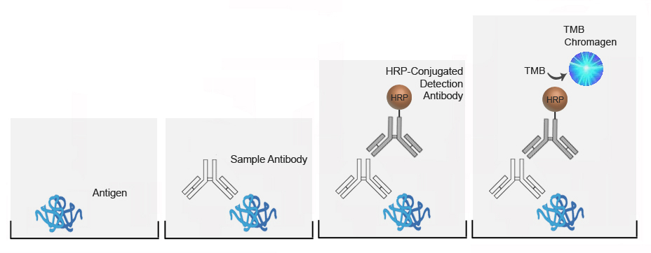
Provider of Global Contract Research Services Accelerating Preclinical Research, Drug Discovery & Therapeutics
Services > ELISA and Cell-based Assays
Antigen adheres to well and unbound antigen is removed
Antibody is added and binds to any antigen present
Detection antibody is added and binds to the primary
antibody
Enzyme present turns over substrate producing a color change
Altogen Labs • 11200 Manchaca Road #203 • Austin • TX • 78748 • USA
Telephone • 512 433 6177 • email • info@altogenlabs.com

Slide 9
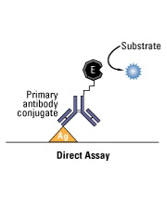
Provider of Global Contract Research Services Accelerating Preclinical Research, Drug Discovery & Therapeutics
Services > ELISA and Cell-based Assays
Direct Elisa
The antigen is incubated overnight in a microtiter plate as the solid phase of the experiment. Unbound antigen is removed by buffer wash steps.
The enzyme-conjugated primary antibody is added to each well. Subsequent buffer wash steps remove unbound antibody.
Upon the addition of substrate, conjugated enzyme produces an optical signal via colorimetric product. This signal is directly proportional to the number of bound primary antibodies and accordingly the amount of antigen present, and the concentration of antigen present in the original solution.
Altogen Labs • 11200 Manchaca Road #203 • Austin • TX • 78748 • USA
Telephone • 512 433 6177 • email • info@altogenlabs.com

Slide 10
Provider of Global Contract Research Services Accelerating Preclinical Research, Drug Discovery & Therapeutics
Services > ELISA and Cell-based Assays
Sandwich ELISA
A known concentration of capture antibody is incubated overnight in a microtiter plate.
Any unbound antibody is removed through buffer wash steps and non-specific surface binding sites are blocked.
Antigen containing solution is added to the plate.
Any unbound antigen is removed through buffer wash steps.
A primary antibody is added, and the wells are washed again to remove non-binders.
A secondary, enzyme-conjugated, antibody targeting the Fc region of the primary is added. Wash steps are repeated to remove any non binders.
The substrate for the conjugated-enzyme is added and the colorimetric reaction is allowed to develop for a finite time period.
A stop solution is added and the optical density (OD) of the wells is measured.
Test solution concentrations of antigen can be calculated from linear regression of a standard curve.
Altogen Labs • 11200 Manchaca Road #203 • Austin • TX • 78748 • USA
Telephone • 512 433 6177 • email • info@altogenlabs.com

Slide 11
Provider of Global Contract Research Services Accelerating Preclinical Research, Drug Discovery & Therapeutics
Services > ELISA and Cell-based Assays
Biotin Conjugation
The biotinylated primary antibody binds to an epitope on the antigen’s surface producing the antibody “sandwich”
A streptavidin-conjugated enzyme is added, which specifically targets the biotin moiety of the primary antibody, linking enzyme produced colorimetric product to bound antibody and bound antigen.
Altogen Labs • 11200 Manchaca Road #203 • Austin • TX • 78748 • USA
Telephone • 512 433 6177 • email • info@altogenlabs.com

Slide 12
Provider of Global Contract Research Services Accelerating Preclinical Research, Drug Discovery & Therapeutics
Services > ELISA and Cell-based Assays
Competitive ELISA
A microtiter plate is coated with antigen overnight. Non-bound antigen is removed by wash steps.
Unlabeled antibody is incubated with antigen-containing solutions.
Antibody-antigen complexes are added to antigen-coated wells. Non-bound enzyme is removed through buffer wash steps.
An enzyme-conjugated secondary antibody, targeting the Fc region of the primary antibody, is added and wash steps are repeated to remove any non-binders.
The substrate is added and allowed to develop before reading OD.
The more antigen present in the test solution, the less free antibody will be available to be captured by surface-bound antigen, hence a higher concentration of analyte in solution, the lower the optical signal.
Optical Density
Analyte Concentration
Altogen Labs • 11200 Manchaca Road #203 • Austin • TX • 78748 • USA
Telephone • 512 433 6177 • email • info@altogenlabs.com

Slide 13
Provider of Global Contract Research Services Accelerating Preclinical Research, Drug Discovery & Therapeutics
Services > ELISA and Cell-based Assays
Advantages
Disadvantages
ELISAs are generally more accurate, sensitive, and specific compared to other assays
ELISAs are safer as they don’t need radioisotopes.
Can detect down to nanogram levels of target antigen.
The use of antibody-antigen binding in ELISAs makes it a highly specific test, binding only to target epitopes relevant to the study.
ELISAs are time sensitive assay and require appropriate incubation for accurate results; incubating too long or too short can distort data
All steps of the assay are critical, hence, washes must be thorough in order to not have skewed data.
For optimal results, antibodies may need to be produced and engineered, which can be expensive and time-consuming.
Altogen Labs • 11200 Manchaca Road #203 • Austin • TX • 78748 • USA
Telephone • 512 433 6177 • email • info@altogenlabs.com

Slide 14
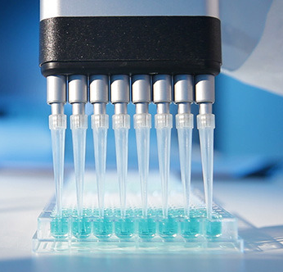
Provider of Global Contract Research Services Accelerating Preclinical Research, Drug Discovery & Therapeutics
Services > Enzyme-Linked Immunosorbent Assay
Altogen Labs Custom ELISA Services
Antibody Labeling, Biotinylation, Purification
Monoclonal Antibody Development
ELISA: Assay Development
ELISA: Platform Optimization
ELISA: Assay Format Modification
Standard ELISA services include testing activity of the compound of interest on a panel of 15 intracellular Ser/Thr kinases and 17 Tyr kinases to detect substrate-specific phosphorylation activity induced by kinase activation.
Altogen Labs’ ELISA service is multifaceted and thorough.
Altogen Labs • 11200 Manchaca Road #203 • Austin • TX • 78748 • USA
Telephone • 512 433 6177 • email • info@altogenlabs.com

Slide 15
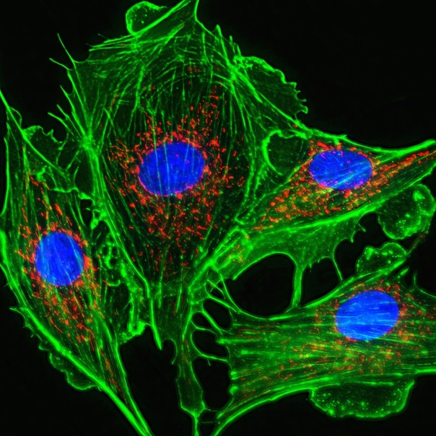
Provider of Global Contract Research Services Accelerating Preclinical Research, Drug Discovery & Therapeutics
Services > ELISA and Cell-based Assays
Cell-Based Assays
Allow study of cellular processes in situ
Leveraged to get an accurate assessment of the system functioning as a whole, not just the “sum of the cellular parts”
Can be utilized to investigate receptor activation, receptor binding, cell signaling, and ligand internalization
Altogen Labs offers custom cell-based assay development and testing
Photo credit: http://www.ddw-online.com
Altogen Labs • 11200 Manchaca Road #203 • Austin • TX • 78748 • USA
Telephone • 512 433 6177 • email • info@altogenlabs.com

Slide 16
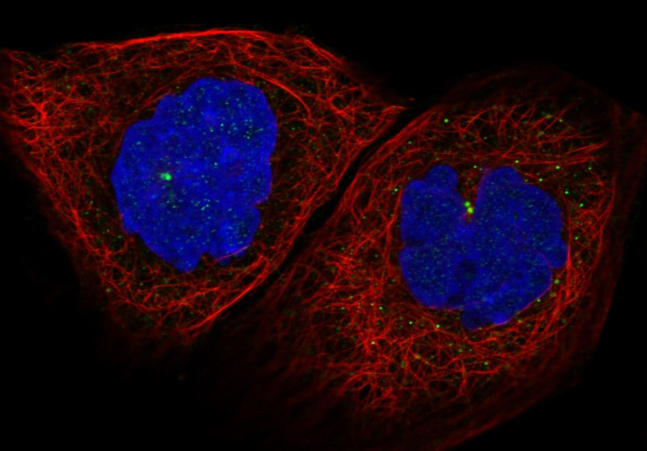
Provider of Global Contract Research Services Accelerating Preclinical Research, Drug Discovery & Therapeutics
Services > ELISA and Cell-based Assays
Types of Cell-Based Assays
Cytotoxic assays – used to assess the cytotoxicity of a compound of interest
Metabolic assays – what effect does a drug have on metabolic turnover
Cell-based assays have a wide range of applications
Photo credit: http://www.proteinatlas.org
Altogen Labs • 11200 Manchaca Road #203 • Austin • TX • 78748 • USA
Telephone • 512 433 6177 • email • info@altogenlabs.com

Slide 17
Provider of Global Contract Research Services Accelerating Preclinical Research, Drug Discovery & Therapeutics
Services > ELISA and Cell-based Assays
Cytotoxic Assay
Drug of interest is administered to cells
Per time interval post-drug treatment, reagent is added to cells
Necrotic cells have compromised membranes, allowing reagent access to DNA resulting in a visible signal
Drug
Fluorescent DNA•Drug Complex
72hr
DNA
Fluorescence
48hr
24hr
4hr
Viable Cell
Necrotic Cell
Drug Concentration
Altogen Labs • 11200 Manchaca Road #203 • Austin • TX • 78748 • USA
Telephone • 512 433 6177 • email • info@altogenlabs.com

Slide 18
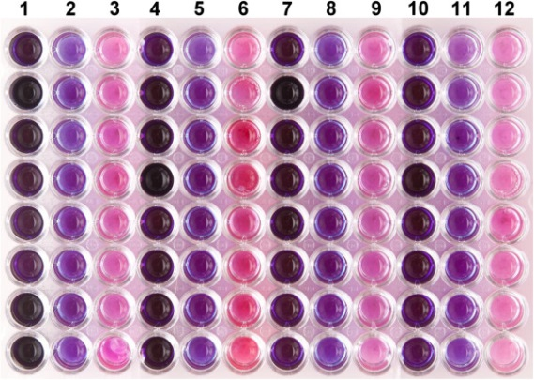
Provider of Global Contract Research Services Accelerating Preclinical Research, Drug Discovery & Therapeutics
Services > ELISA and Cell-based Assays
Altogen Labs has a staff of scientists experienced with ELISA development, optimization, and modification
Altogen Labs’ standard ELISA service includes screening against a panel of 15 intracellular Ser/Thr kinases and 17 Tyr kinases for substrate phosphorylation activity
Our laboratory is trained and equipped to perform any study under Good Laboratory Practices (GLP)
Altogen Labs can tailor cell-based assays to our client’s needs
Hudman DA, Sargentini NJ. Resazurin-based assay for screening bacteria for radiation sensitivity. SpringerPlus. 2013;2:55.
Contact us to discuss details, timeline estimates, and get price quotes!
Altogen Labs • 11200 Manchaca Road #203 • Austin • TX • 78748 • USA
Telephone • 512 433 6177 • email • info@altogenlabs.com

